Slide 1
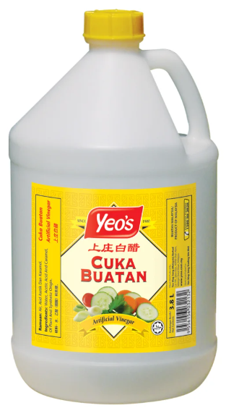
ACETIC ACID
Acetic acid is an organic acid.
It lowers the pH in the chicken’s intestine.
A lower pH inhibits harmful bacteria.
It promotes the growth of beneficial bacteria, such as Lactobacillus.
Alternative to antibiotics
Recommended inclusion rate:
0.1% to 0.5% (i.e., 1 to 5 mL/1L water)

Slide 2
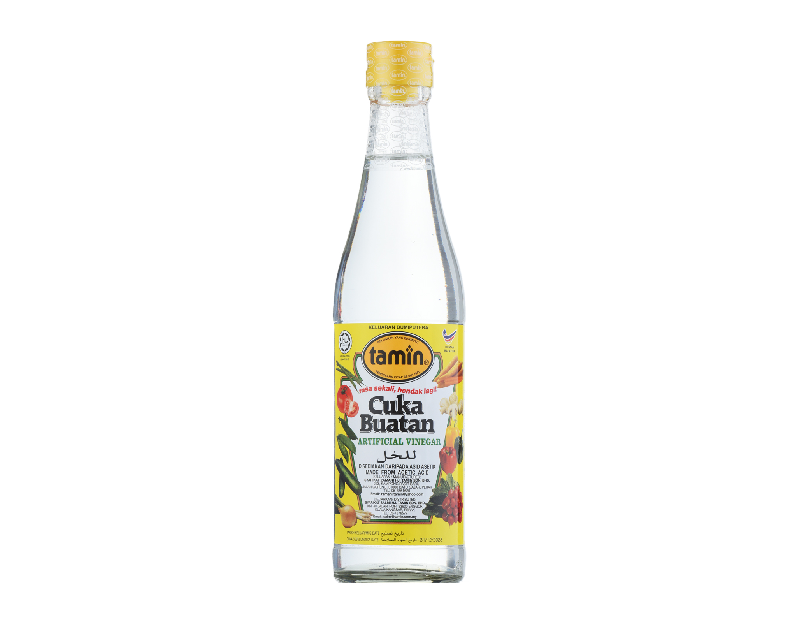
Kitchen acetic acid (white vinegar) is typically 4 - 6% in concentration.
Proposed Inclusion Rate:
1L → 500 gallons of water

Slide 3
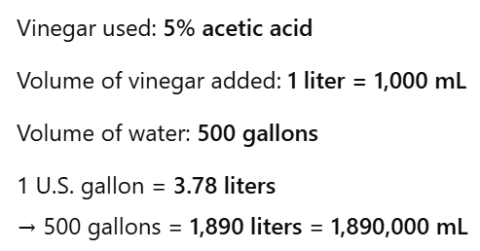


Calculation for 5% acetic acid =
Amount of pure acetic acid =
Final concentration (%) =

Slide 4
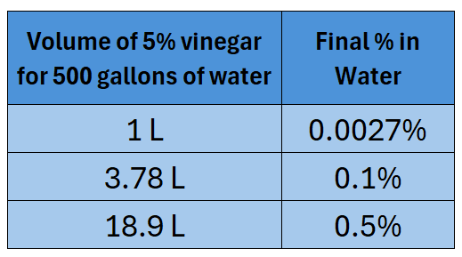
1L → 500 gallons of water
is below the typical range (0.1% to 0.5%). So it is generally safe.

